Slide 1


WEB SCRAPING IN E-COMMERCE WEBSITE
BY
KUNGUMA ROSHAN M
PARTHIBAN S

Slide 2
ABSTRACT
The "WEB DATA SCRAPING AND DATA ANALYSIS IN E-COMMERCE WEBSITE" is an innovative use of web scraping techniques, important data is extracted from e-commerce platforms. The acquired data is then analyzed to provide insights into consumer behavior, market trends, and rival plans. A range of data analysis techniques, such as sentiment analysis, predictive modeling, and descriptive statistics, are utilized to derive actionable insights for e-commerce enterprises. In the cutthroat world of e-commerce, the findings help to improve decision-making procedures, maximize marketing tactics, and boost overall business success.

Slide 3
WHAT IS WEB SCRAPING
It develops an automated web scraping solution using UiPath to extract e-commerce product data. Users can define filters like price, brand, discount, and ratings. The bot collects product names, prices, availability, and reviews from both static and dynamic pages. UiPath automation capabilities like UI automation and data scraping are utilized. For dynamic content and CAPTCHAs, headless browsing, delays, and API-based extraction are used. Extracted data is stored in Excel, CSV, or databases for analysis. The solution helps businesses track pricing trends and competitors. Compliance with ethical and legal standards is prioritized. The automation enhances decision-making for both businesses and consumers.

Slide 4


PROBLEM DEFINITION
Manually collecting product data from e-commerce websites is time- consuming and inefficient. Websites use dynamic content and anti-scraping measures like CAPTCHAs and IP blocking, making data extraction difficult. Traditional methods fail to handle these challenges effectively. This project develops an automated web scraping system to extract data based on user-defined conditions while ensuring ethical compliance.

Slide 5

HARDWARE & SOFTWARE ENVIROMENT
1. Processor(CPU) (HARDWARE)
2. RAM (HARDWARE)
3. Storage(HARDWARE)
4. Network(HARDWARE)
5. UI-Path Studio (SOFTWARE)
6. Web Brower(SOFTWARE)
7. Database Storage (SOFTWARE)

Slide 6
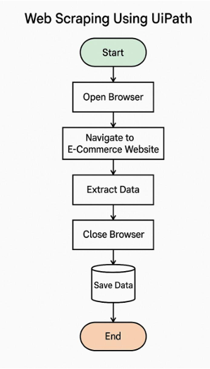
FLOWCHART
The web scraping process using UiPath starts by launching a browser and navigating to the target e-commerce website. The bot then identifies and extracts relevant product details such as names, prices, and availability using UiPath’s data scraping capabilities. If the website has multiple pages, the bot loops through them to ensure all data is collected efficiently. Once the extraction is complete, the data is stored in a structured format like an Excel file, database, or CSV. Finally, the browser is closed, and the automation process ends, ensuring efficient and accurate data retrieval.

Slide 7
MODULE DESCRIPTION
Launch Browser - UiPath uses the Open Browser activity to launch the e- commerce website and navigate to the product pages you want to scrape.
Type Into – Used to Scrap the Search Bar for the Product which we want from the User
Table Extraction - Table extraction in UiPath efficiently captures structured data from web pages or documents, preserving rows and columns for easy processing. It automates the collection of tabular data, such as product details, and stores it in formats like Excel or CSV for further use.
Filter Data Table - Filtering a data table in UiPath allows you to extract specific rows based on certain conditions, such as price ranges or product.
Write Range Workbook - The Write Range activity in UiPath writes data from a DataTable into an Excel worksheet. It allows you to specify the starting cell and the range of cells where the data will be written, either overwriting or appending to existing data.

Slide 8
Existing Systems
Manual Web Scraping - Involves copying and pasting data manually from websites.
Time-consuming and inefficient for large-scale data extraction.
2. Browser Extensions & Low-Code Tools -
Tools like Web Scraper (Chrome Extension) and ParseHub offer UI-based data extraction.
Suitable for non-programmers but may struggle with complex websites and dynamic content.
3.Open-Source Web Scraping Frameworks -
Scrapy
BeautifulSoup
Selicum

Slide 9
Future Enhancements
1. Advanced Anti-Scraping Bypass Mechanisms – The use of human-like behavior simulation, headless browsers, and rotating proxies will improve bot resilience against CAPTCHA and IP blocking.
2. AI & Machine Learning Integration – AI-driven data parsing and ML models can enhance data categorization, detect patterns, and handle unstructured data more effectively.
3. Automated Adaptation to Website Changes – AI-powered scrapers will self-adjust to website structure changes, reducing downtime and the need for manual updates.
4. Multi-Platform Scraping – Future scrapers will support data extraction from mobile apps, Progressive Web Apps (PWAs), and voice search-enabled platforms.

Slide 10
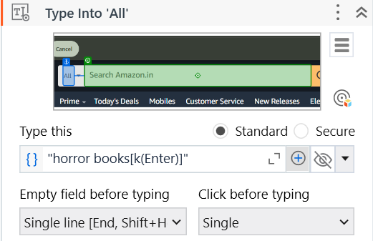
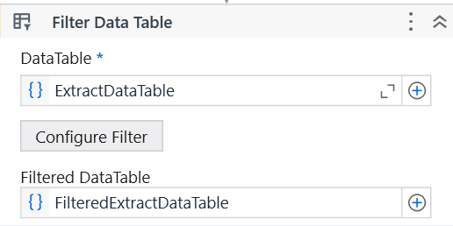
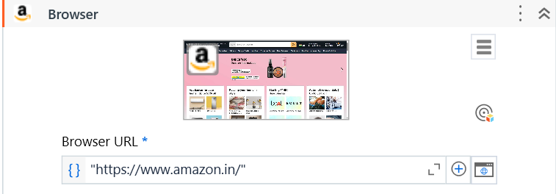
OUTCOMES

Slide 11
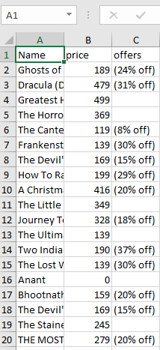
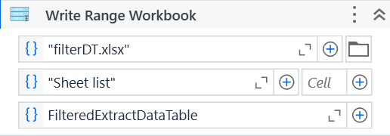
RESULTS

Slide 12
CONCLUSION
Web scraping is a powerful technique for extracting and analyzing web data, benefiting businesses, researchers, and analysts. It automates data collection, enabling price tracking, market research, and competitive analysis. Modern tools like Scrapy, Selenium, and AI-powered platforms enhance scraping efficiency. However, challenges like CAPTCHAs, IP blocking, and legal restrictions pose obstacles. Ethical concerns, including data privacy and compliance, must be addressed. Headless browsing, proxy rotation, and API-based extraction help overcome technical barriers. Maintaining scraper functionality requires adapting to website changes. Cloud-based solutions simplify large-scale data scraping. Ensuring compliance with laws and ethical guidelines is crucial. Web scraping continues to evolve, driving data-driven decision-making.

Slide 13
THANK YOU ALL !!!

